Slide 1

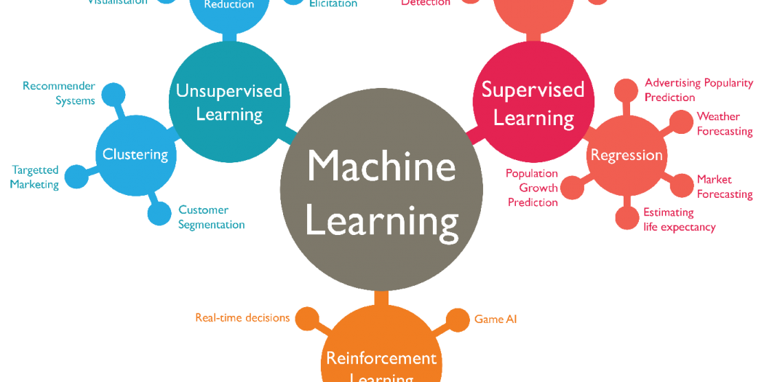



CSE 6363 MACHINE LEARNING
RESTAURANT REVIEW ANALYSIS
Team members:
Kommabathula Sowmya(1002034779)
Singampalli Venkata Karun

Slide 2

TABLE OF CONTENTS
Introduction
Problem statement
Model 1 - Naive Bayes
Model 1 to Restaurant Review Analysis
Results
Model 2 - Logistic Regression
Model 2 to Restaurant Review Analysis
Results
Model 3 - Random Forest
Model 3 to Restaurant Analysis
Results
Accuracy Score
Visualizations
Applications

Slide 3

INTRODUCTION
There are several methods to analyze customer reviews for a restaurant, such as Naive Bayes, Regression, and Random Forest. We will be using these three models to analyze restaurant reviews and will explain each model in subsequent slides. Afterwards, we will compare the accuracy scores of each model to determine which one is best suited for the chosen dataset. Finally, we will identify and present the best model for the given dataset

Slide 4

PROBLEM STATEMENT
Restaurant Review Analysis
We aim to build a Machine Learning model that can accurately detect the various sentiments expressed in a collection of English sentences or large paragraphs, such as reviews. The model's objective is to correctly identify the sentiment of users' reviews, which can be either positive or negative. Therefore, we will classify reviews as either positive or negative based on their sentiment.

Slide 5

DATASET
We have used the Data set from kaggle and below is the hyperlink to the data set
It has around 1000 reviews
https://www.kaggle.com/datasets/hj5992/restaurantreviews?resource=download

Slide 6
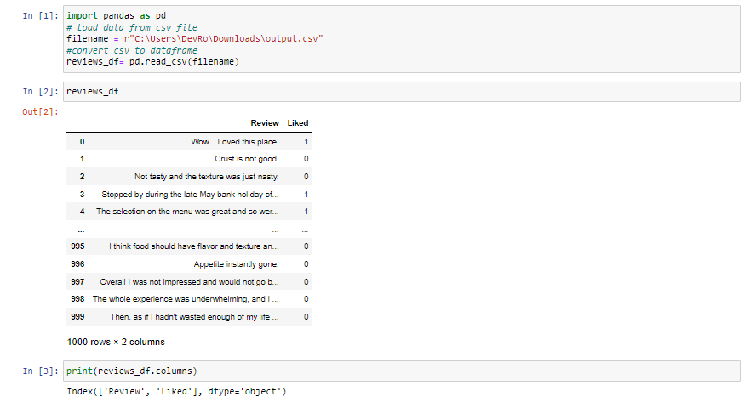
DATA PREPROCESSING
We created a data frame reviews_df that has the columns Review and Liked

Slide 7
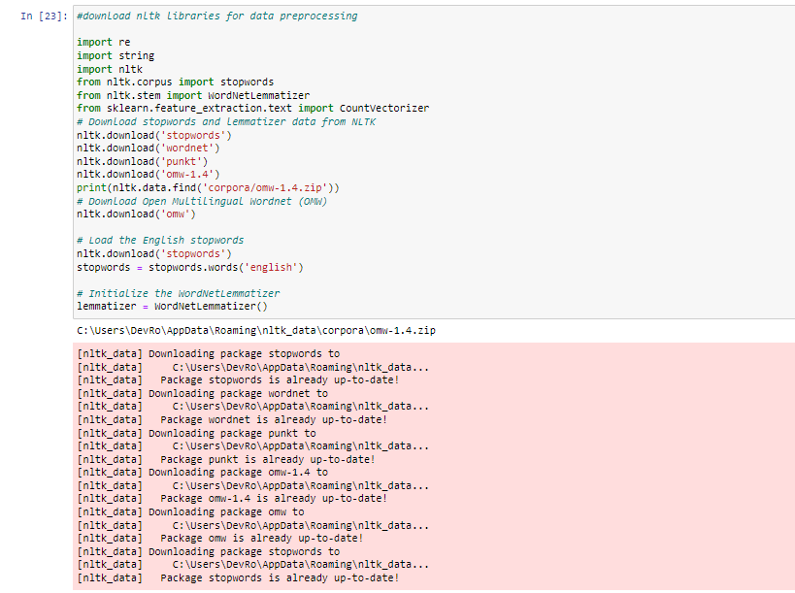
DATA PREPROCESSING
Download the data and libraries required for textual data preparation. It begins by loading the necessary libraries, including the CountVectorizer module from Scikit-learn, regular expression, string, and NLTK (Natural Language Toolkit), a toolkit for NLP (Natural Language Processing).The method then sets the English stopwords as a variable and downloads lemmatizer and stopword data from NLTK and Open Multilingual Wordnet (OMW). The WordNetLemmatizer, which is used to break down words into their root or base form, is then initialized.

Slide 8
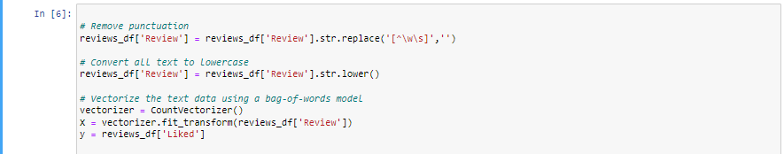
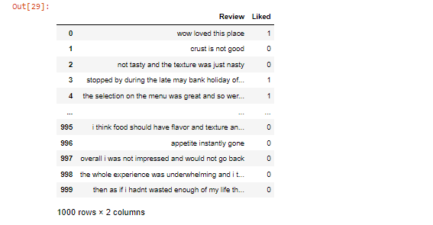
DATA PREPROCESSING
These code lines perform text preprocessing and vectorization on the Review column of the reviews_df dataframe.The first line removes all punctuation from the text using regular expression.The second line converts all text to lowercase using the .lower() method. This is done to standardize the text and ensure that uppercase and lowercase letters are treated as the same.The third and fourth lines vectorize the text data using a bag-of-words model. This converts the text data into a matrix of word counts, where each row corresponds to a review and each column corresponds to a unique word in the corpus. The resulting matrix can be used as input for various machine learning models.The figure shows output after this step.

Slide 9
DATA PREPROCESSING

Slide 10
MODEL 1 NAVIE BAYES

Slide 12
Navie Bayes
The Naive Bayes classifier is a supervised machine learning algorithm, which is used for classification tasks, like text classification. It is also part of a family of generative learning algorithms, meaning that it seeks to model the distribution of inputs of a given class or category
Some best examples of the Naive Bayes Algorithm are sentimental analysis, classifying new articles, and spam filtration. Classification algorithms are used for categorizing new observations into predefined classes for the uninitiated data.

Slide 13
Naïve Bayes Model

Slide 14
MODEL 2 LOGISTIC REGRESSION

Slide 15
Logistic Regression
The type of statistical model is often used for classification and predictive analytics. Logistic regression estimates the probability of an event occurring, such as voted or didn't vote, based on a given dataset of independent variables.
Logistic regression is used to obtain odds ratio in the presence of more than one explanatory variable.

Slide 16
Logistic Regression to Restarant Review Analysis

Slide 17
Results

Slide 18
MODEL 3 Random Forest

Slide 19
Random Forest to Restaurant Review Analysis

Slide 20
Results

Slide 21
ACCURACY SCORE FOR THREE MODELS
 | Model 1 Navie Bayes | Model 2 Logistic Regression | Model 3 Random Forest
Accuracy Score
Precision

Slide 22
VISUALIZATIONS

Slide 23
APPLICATIONS
Our models can be applied for any of the restaurant reviews to find out the positive and negative reviews and the most used words in the reviews, this can help thee management to figure out their strong and weak areas and can use it for the development of the restaurant by enhancing the strong points and improving the weak point. We categorize the review and show the best category of the restaurant using the bag of words while processing the reviews, and show the best category the restaurant is reviewed for (like most of reviews has written about hygiene or food etc)

